Slide 1
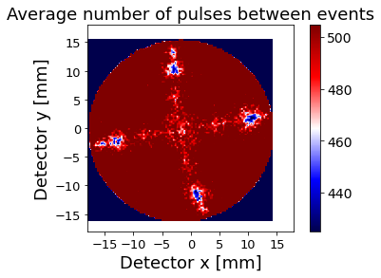
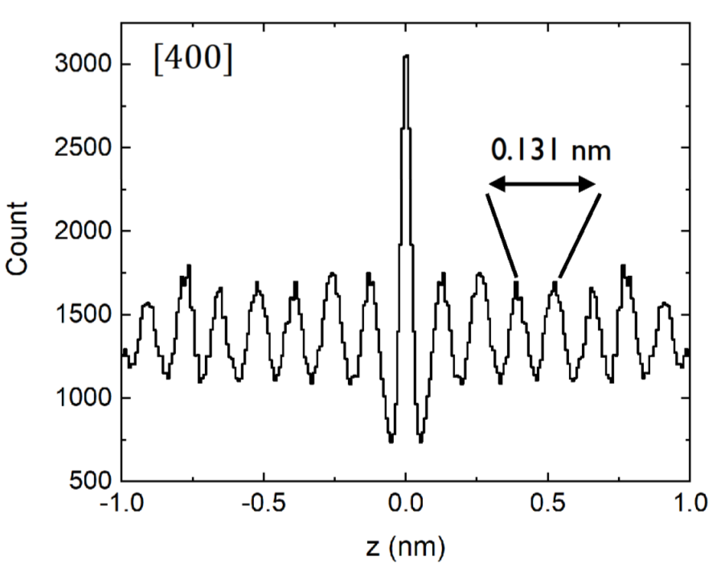
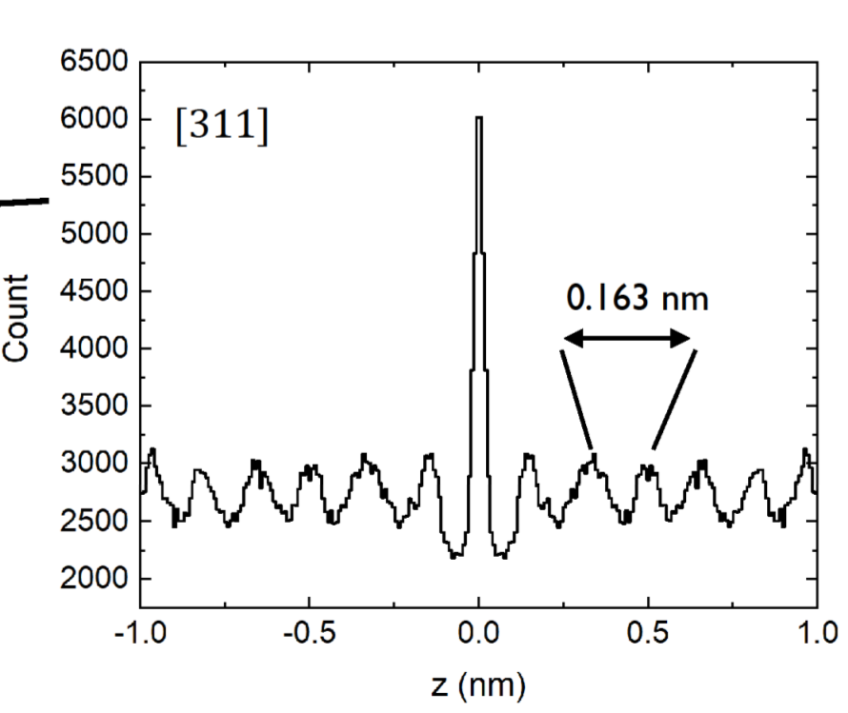
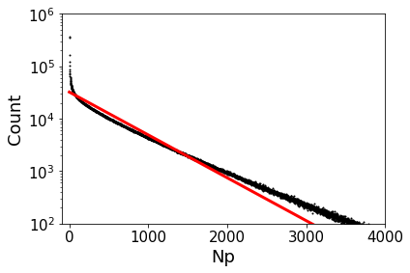
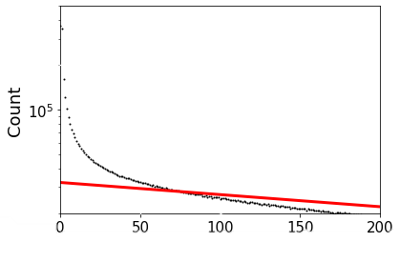
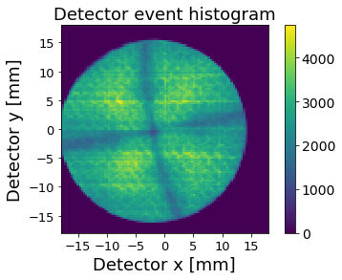
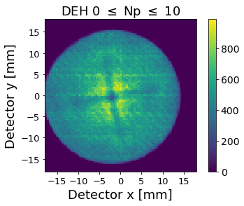
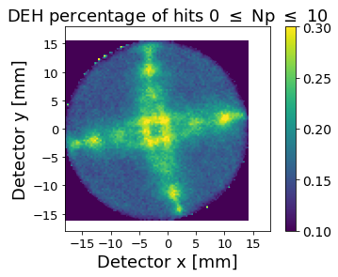
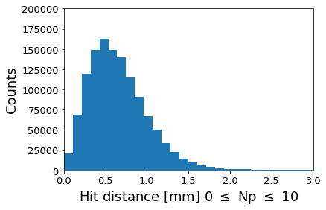
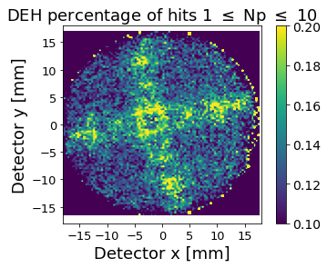
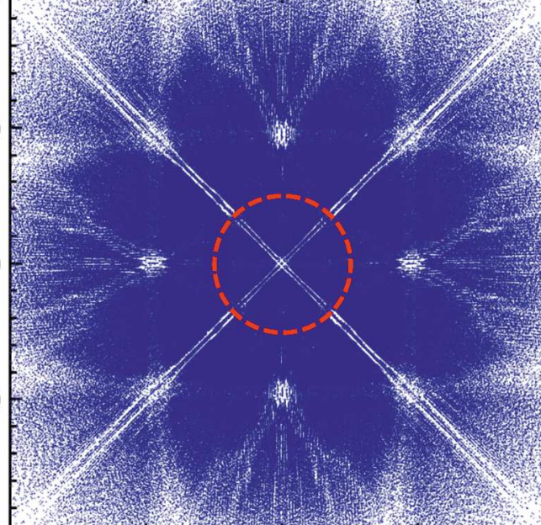
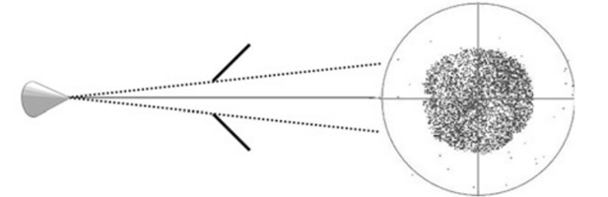
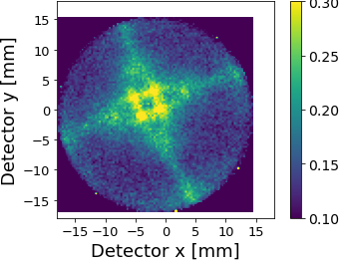

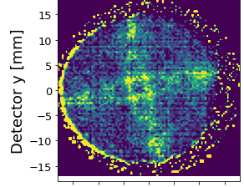

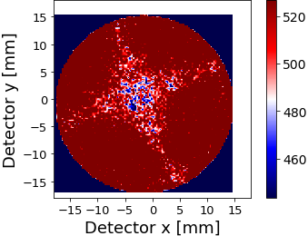
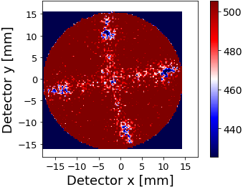
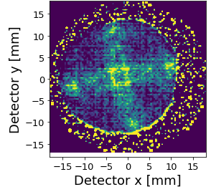





Revealing crystallographic information in Silicon <001> from field desorption images
Jeroen E. Scheerder¹, Yngwie Baron², Richard J.H. Morris¹ and Claudia Fleischmann^{1,3}
¹ imec, Kapeldreef 75, 3001, Leuven, Belgium
² Department of Applied Physics and Science Education, Eindhoven University of Technology, Eindhoven 5612 AZ, The Netherlands
³ KU Leuven, Department of Physics and Astronomy, Quantum Solid-State Physics, B-3001 Leuven, Belgium
Overview
Crystallographic information in APT data can be used to calibrate reconstruction parameters [1]
Accurate reconstruction desirable in semiconductor technology, e.g. for dopant profiling or interface characterization with sub-nm accuracy
Pole and zone lines often readily available in metallic samples from density hit map, but not in semiconductor samples
Various metrics correlated with crystallography (multihits, charge state ratio,...) have been explored to reveal crystallographic information in APT data [2,3]
Success depends on material and experimental parameters (underlying mechanisms not fully understood yet)
In this work:
Detector event histogram (DEH) filters based on the number of pulses between consecutive hits to reveal poles in Si<001>
novel filter, based on the relative amount of events with limited pulses in between, reveals the <311> family and other 4-fold symmetric features, for datasets containing ⪆ 2x10⁶ hits
Practical application: reduction of detector fill with increasing tip-local electrode distance is not caused by changes in image compression, but is a “shadowing effect”
The exact origin of the revealed 4-fold symmetric crystallographic patterns (and significant differences between laser and voltage mode) requires further clarification.
Filtering based on number of pulses between consecutive hits N_{p} for Si
[2,3]
Sb doped Si (Cameca PSM), 20x10⁶ hits acquired on LEAP 5000 XR
base temperature = 50K, Voltage mode PF=20%,
K_{DR}=0.002 ions/pulse (1/K_{DR}~ 500)
Spatial distribution maps (a_{Si} = 0.543 nm d₀₀₄ = 0.136 nm d₃₁₁= 0.164 nm)
N_{p} histogram
Correlated events ~ crystallography
[004]
Poisson (random) [4] P(N_{p})=K_{DR}exp(-N_{p}K_{DR})
Possible mechanism:
At low index poles [5] (center of atomic terrace): atoms subject to higher electric field F while having lower evaporation field F_{e}
which
decreases N_{p} at these locations!
(DEH)
[2,3]
Not random: at small N_{p}, evaporation events correlated in time
$$N_{p}∝exp\left[−C^{te}\frac{F−F_{e}}{F_{e}}\right]$$
A
B
Hit distance between small N_{p}
[4]
Stochastic evaporation
events: peak at ½ detector fill (approx. 15 mm in this case)
Filter APT data in detector space based on N_{p} to reveal obscured crystallographic information
Density on DEH N_{hit}(x,y),
Only reveals center [004] pole in silicon
Filter 0 ≤ N_{p} ≤ 10
Only showing correlated events per pixel N_{p<10}(x,y)
does not reveal much?
Novel filter: N_{p<10}(x,y)/N_{hit}(x,y) (divide panel B by panel A)
Reveals novel poles (<311> family) and other 4-fold symmetric features!
Not random: at small N_{p}, evaporation events correlated in space
Application: image formation
Interpretation?
Goal: understand effect of tip-local electrode distance on image formation in our system
detector
fill
Laser mode (2 pJ)
5x10⁶ hits acquired
Voltage mode (PF 20%)
[6]
detector fill
0 μm
0.30
0.30
tip
local electrode(LE)
detector
distance [004]-[311]
(detector)
detector fill (radius)
Percentage of hits 0 ≤ N_{p} ≤ 10
[004]
distance [004]-[311]
increase in tip-LE distance [μm]
Forward simulation
DEH Si 〈001〉 [8]
6 μm
[004]
Average N_{p} between events
Double line / square feature
near centre pole, reminiscent of forward simulations?
With increasing tip-LE distance, detector fill decreases, while distance between poles remains constant within uncertainty.
This suggests limited change in image magnification and compression, and thus the shrinking detector fill is a result from the local electrode ‘shadowing’ the signal. (in agreement with [7])
5 um
12 μm
2x10⁶ hits acquired
Voltage mode PF=20%.
Filters applied to laser mode data reveal different 4-fold symmetric features than in voltage mode
Link to differences in field evaporation between modes (Field of View, surface dynamics, ...?) Further investigation!
References & Acknowledgements
Contact
[5] L. Yao et al., Appl. Phys. Lett. 107, 241602 (2015)
[6] M.K. Miller and R.G. Forbes, Atom-Probe Tomography: The Local Electrode Atom Probe, Springer, New York (USA), 2014
[7] B. Gault et al., J. Appl. Phys. 105, 248 (2009)
[8] Y.-T. Ling et al., Microsc. Microanal. 4, 1102 (2022)
We thank M.Sc. Viktor de Ridder for part of the data acquisition, and prof. A. Vantomme (KUL) and
prof. P. Koenraad (TU/e) for fruitful discussions
[1] B. Gault et al., Miscrosc. Microanal. 12, 296 (2008)
[2] L. Yao et al., MethodsX 3, 268 (2016)
[3] A.J. Breen et al., Ultramicroscopy 243, 113640 (2023)
[4] F. De Geuser et al., Surf. Sci. 601, 536 (2007)
Jeroen.Scheerder@imec.be

